Slide 1
Bray Team Week 7 Update
Avery Haynes, Locke Lehmann, Travis Carlson, Cody Sims, Zachary Walker, Michael Hager
3/4/2024

Slide 2
Weekly Deliverables
Tasks | Lead | Percentage Done | Notes
Receive remaining parts | Avery | 100% | Components have been received from vendors and from Bray.
Build frame for valve and actuator | Cody/Travis | 50% | Got some modeling done for frame.
Implement sensors into system | Zack | 25% | Attempted to drill into stop bolts.
Wire sensors into DAQ and computer | Michael | 50% | Wired connections made for one deliverable, working on ADC chip.
Build motor mount | Locke/Travis | 50% | Modeled, must 3D print

Slide 3
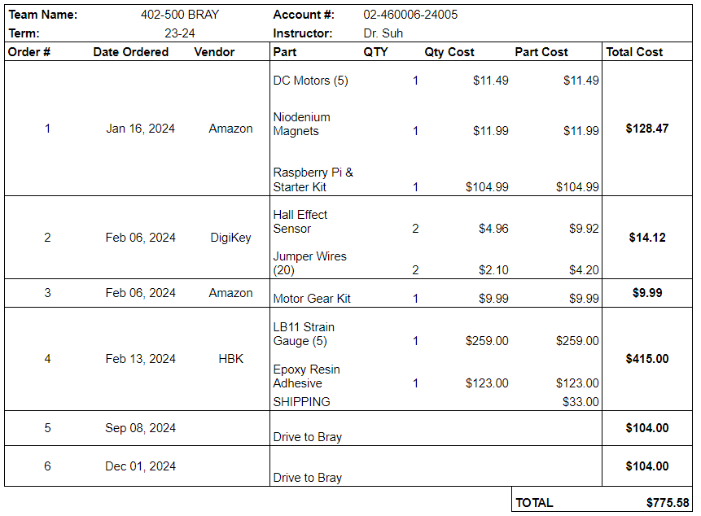
Purchasing Updates
Orders from Amazon, Digikey, HBK, and Bray have all arrived.
This should be all the parts we need for the project.
Budget Update: $775.58 spent (out of $3,803 approved)
Notes:
Done - Avery 2/18

Slide 4
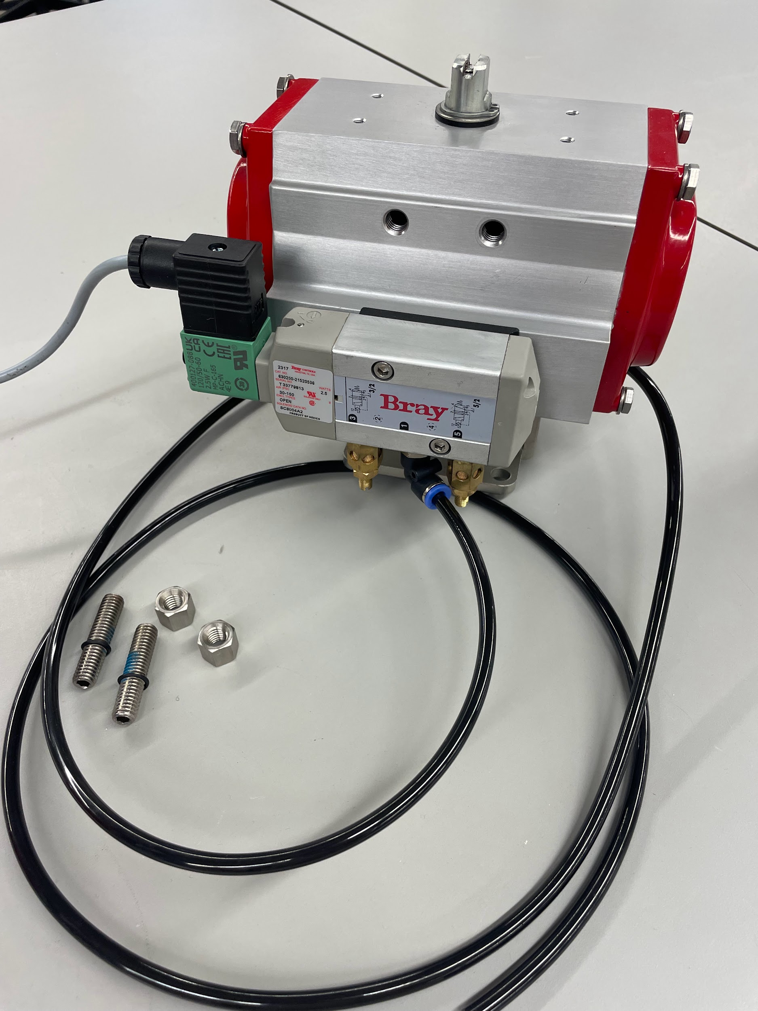
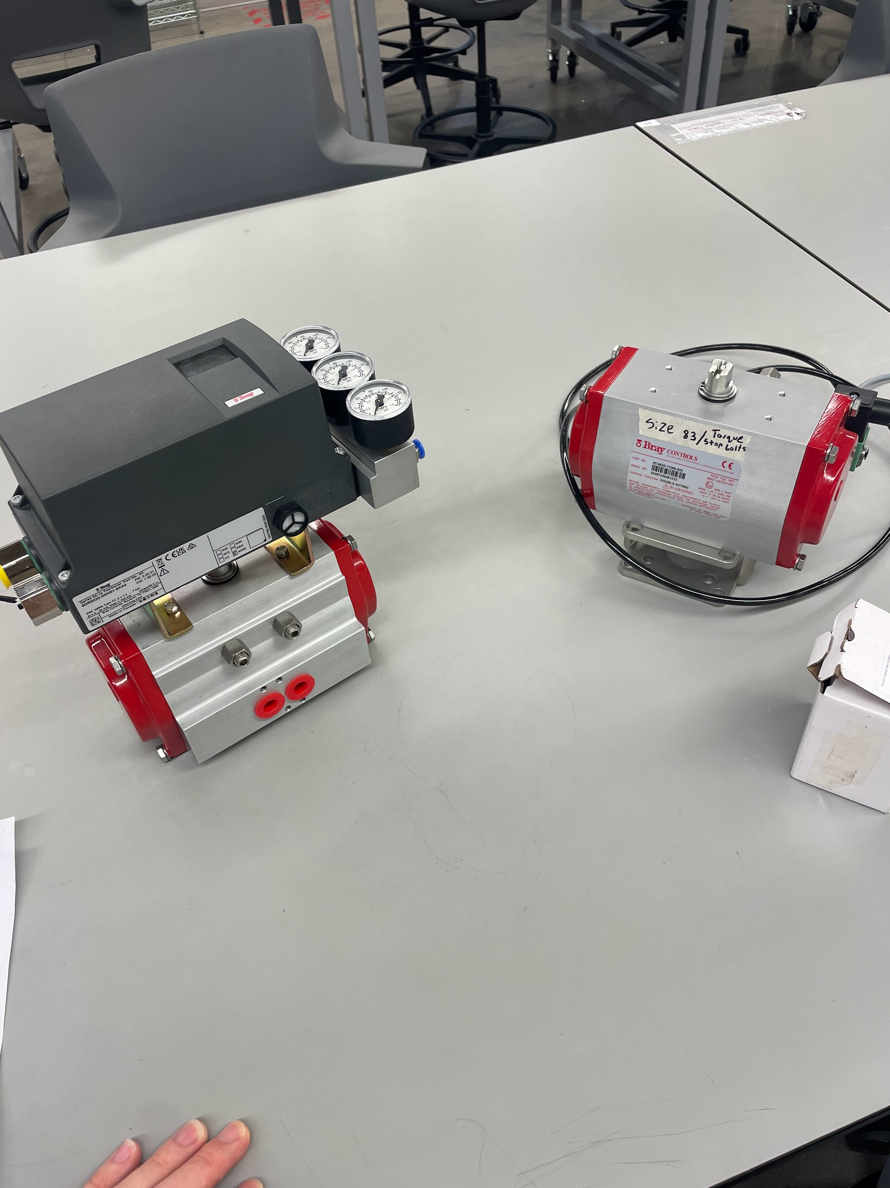
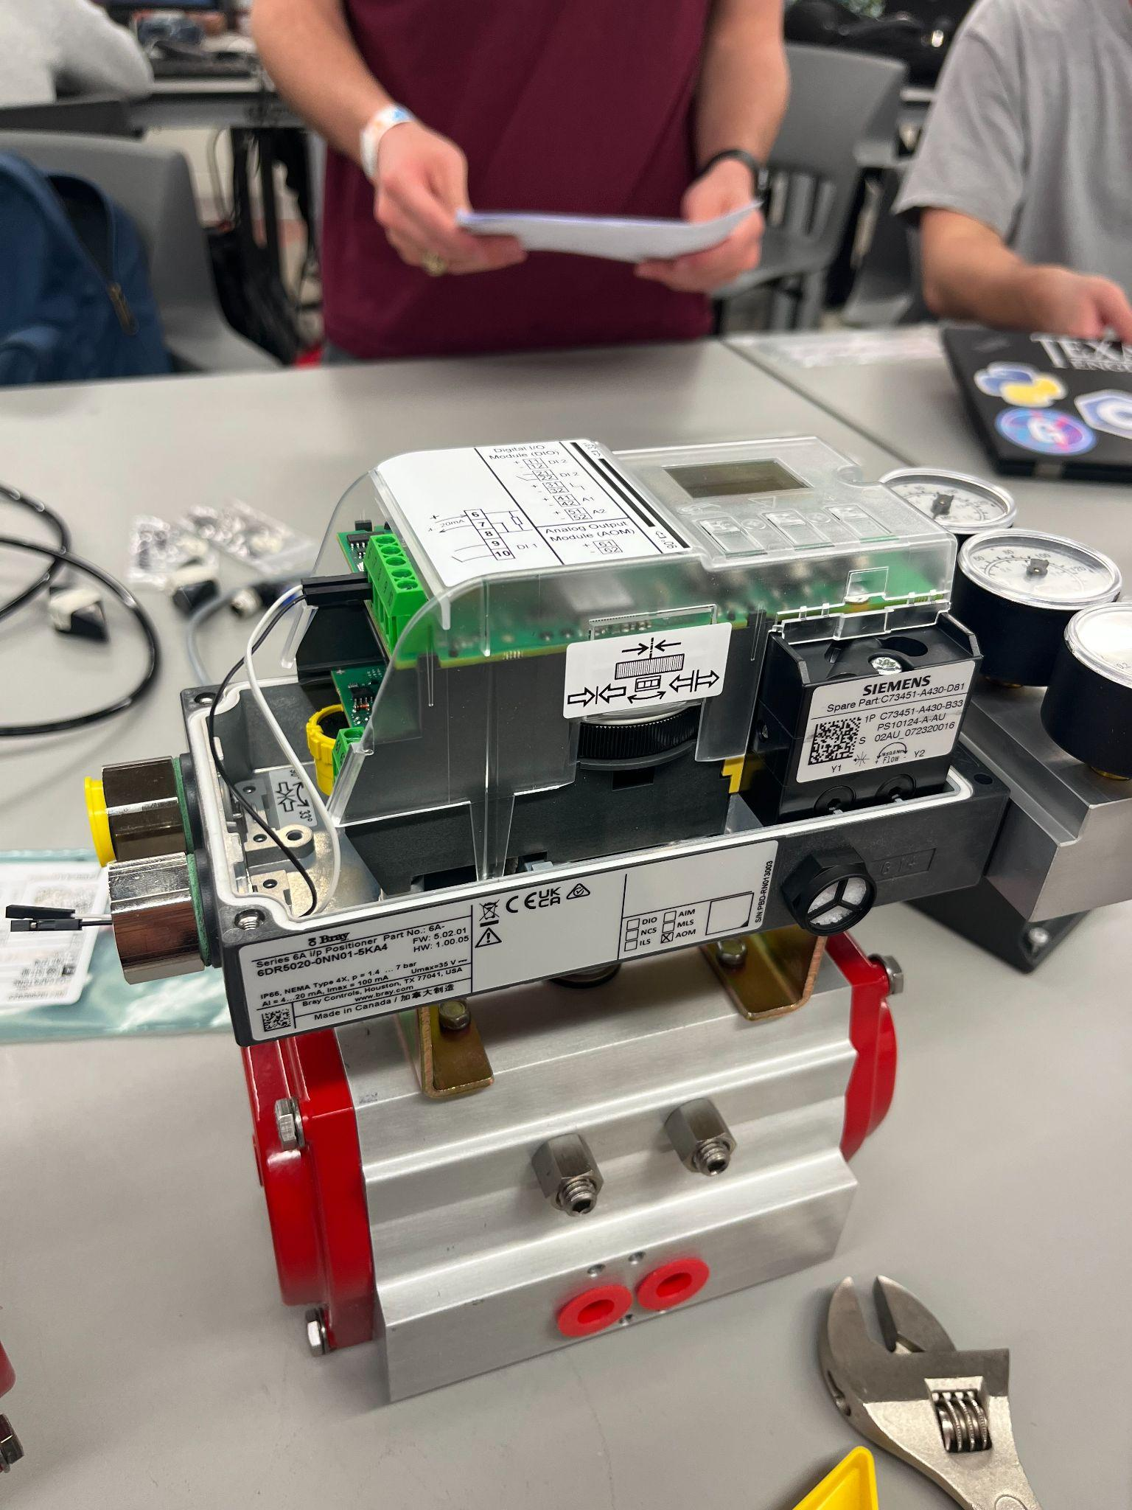
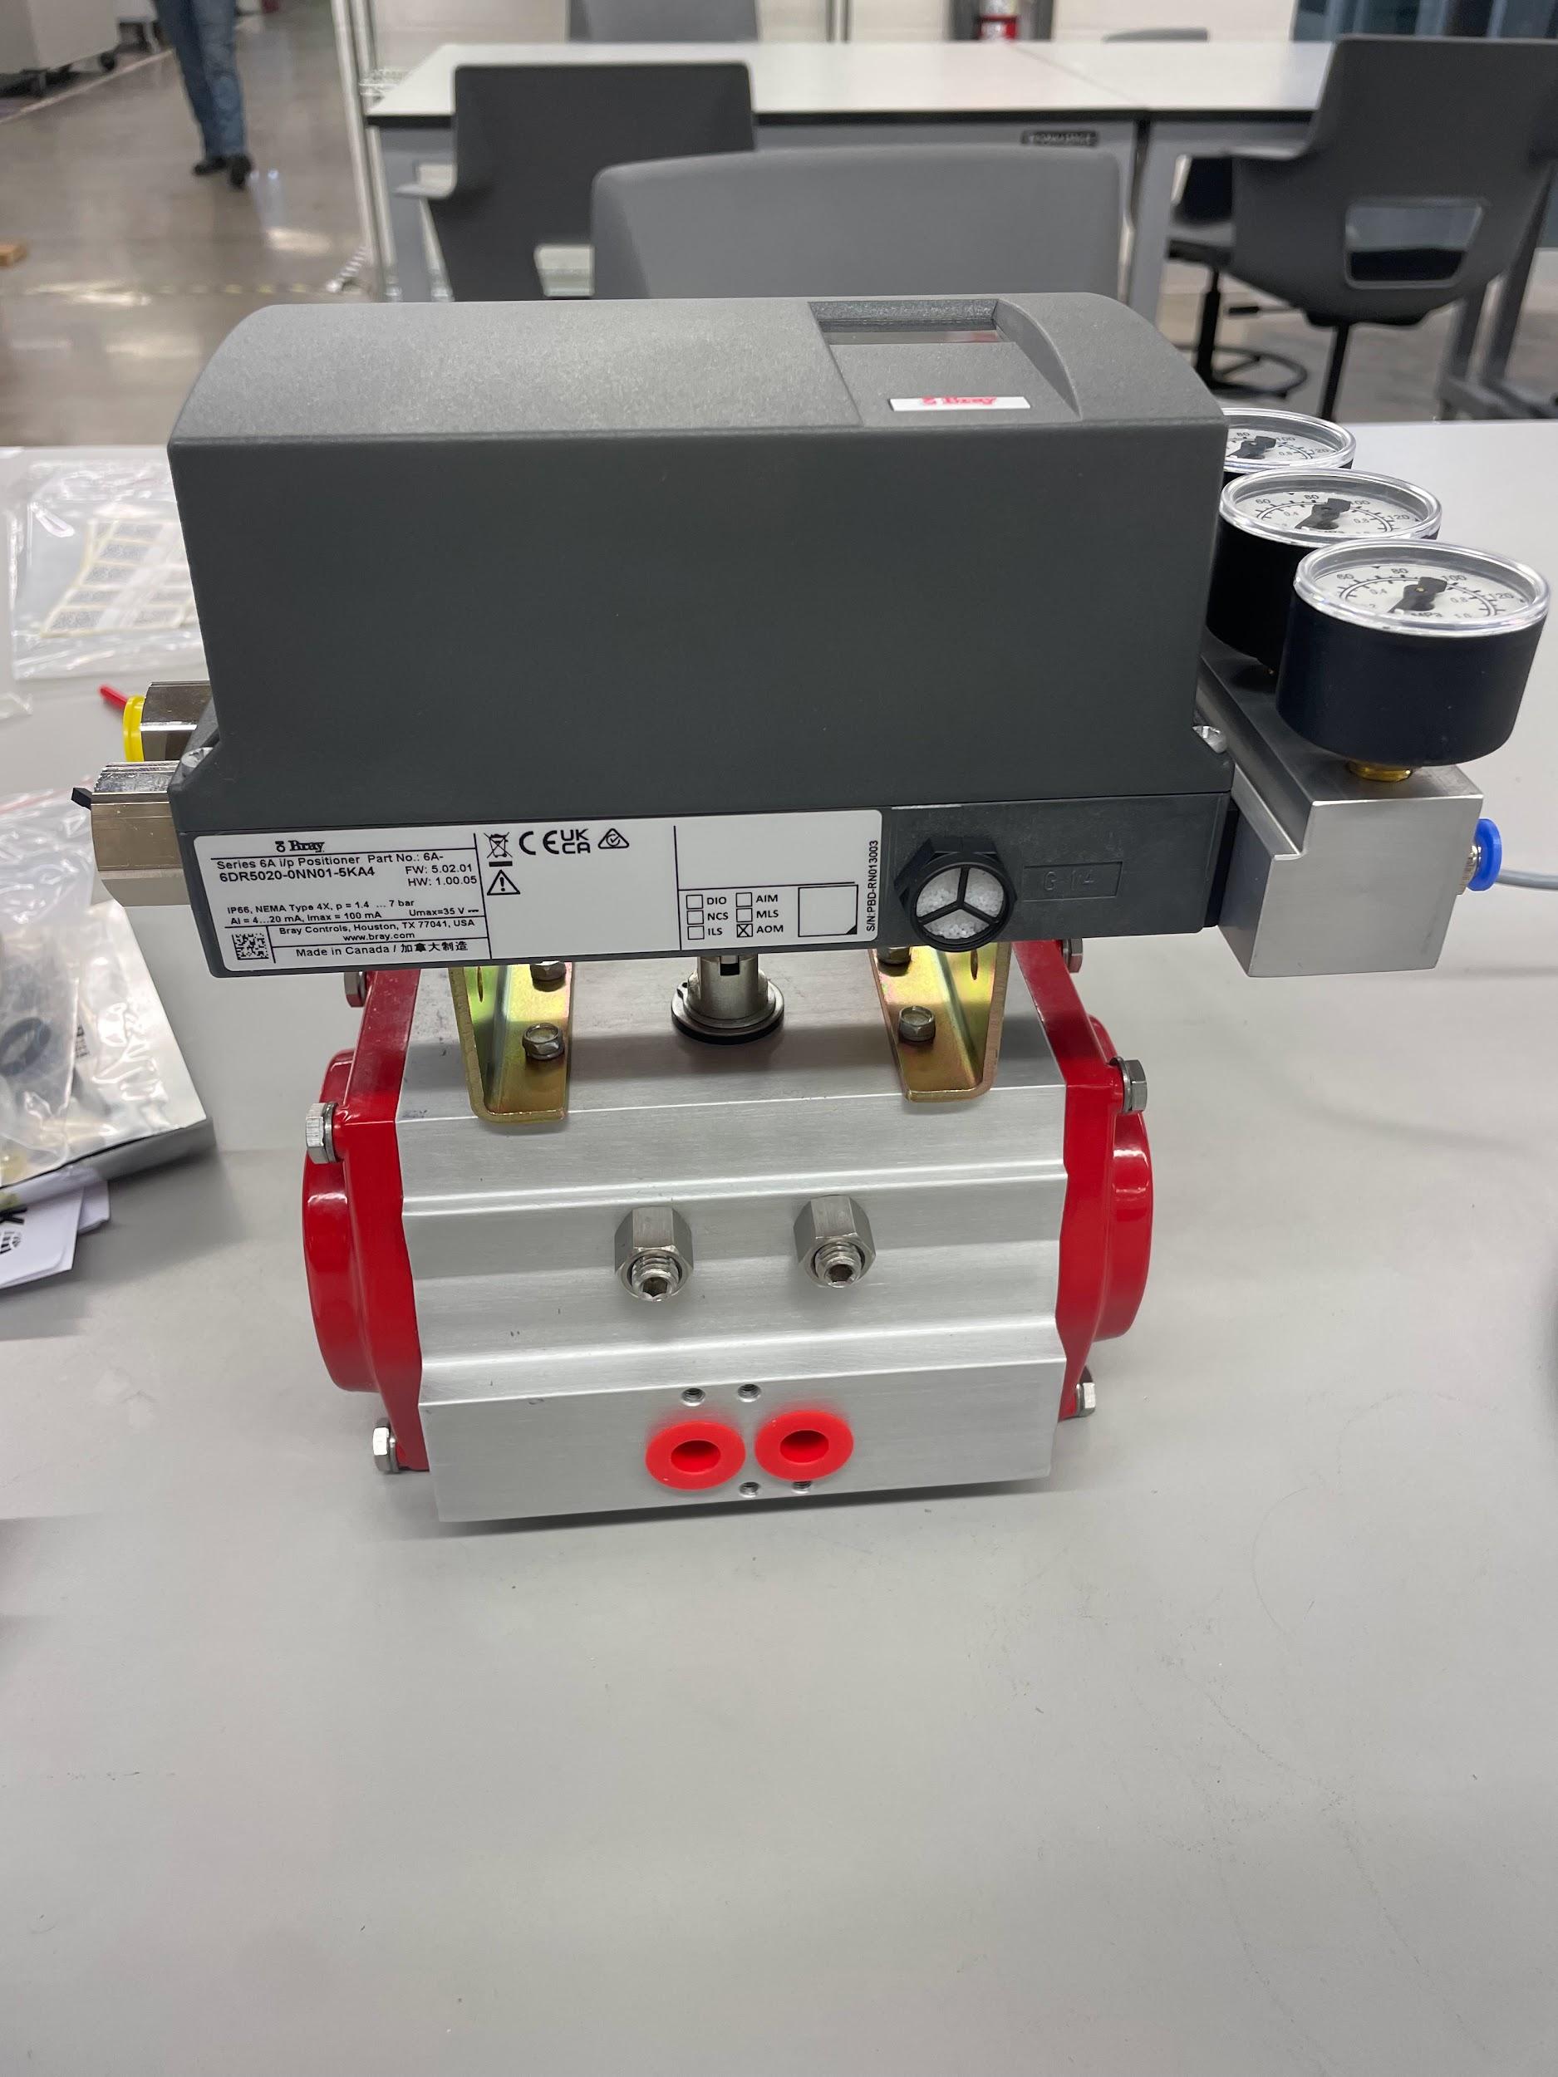
FEDC Air / Bray Parts
Received all parts from Bray
Hooked up parts together for air supply connection from FEDC shop air
Could not calibrate positioner due to ECEN event using power supply

Slide 5
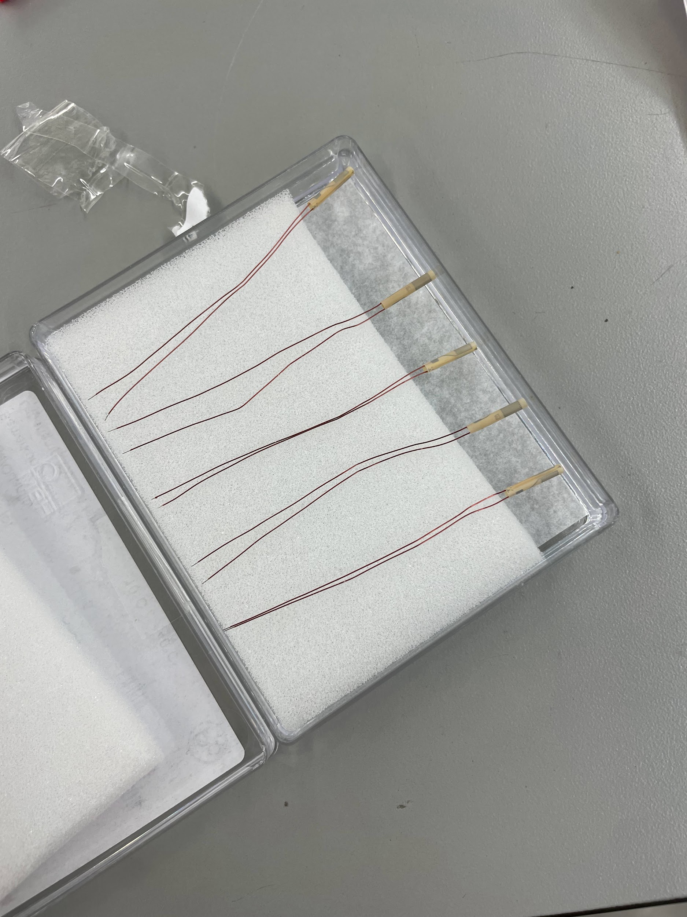
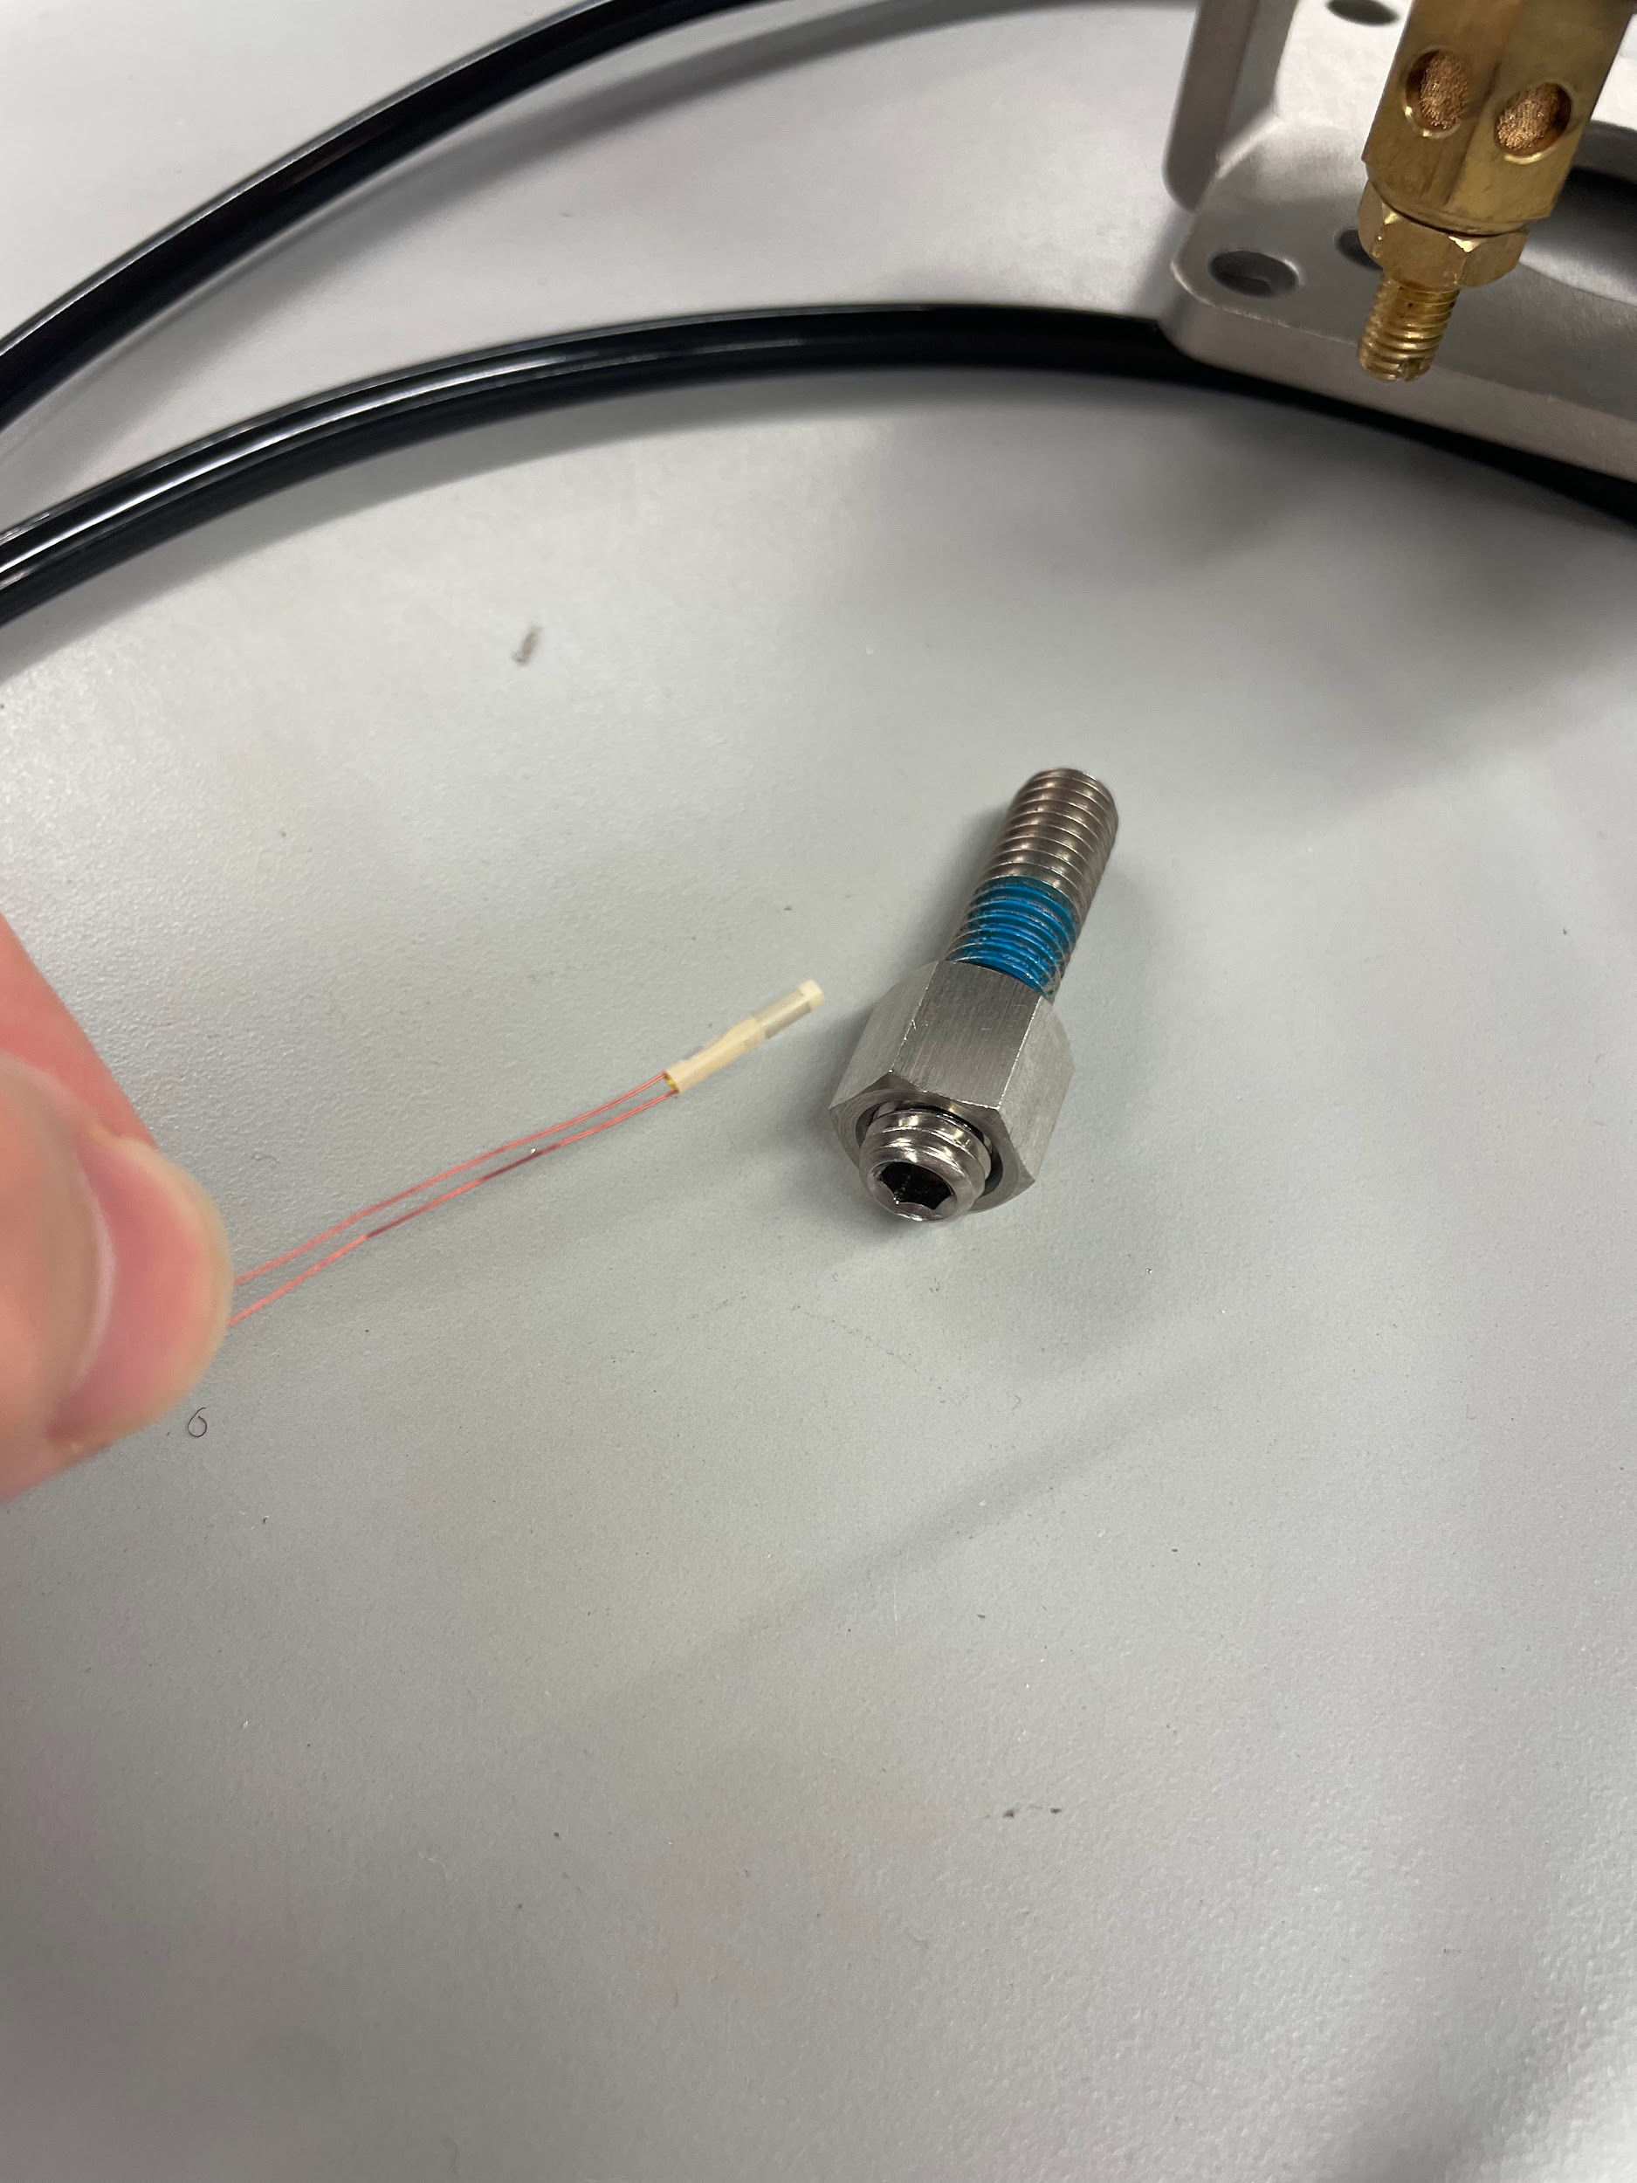
Strain Gauges
Cylindrical Strain gauges from HBK arrived
Broke a bit trying to drill the 2 mm hole - setback but we have extra bolts from other identical actuators
Ask FEDC staff for guidance on best
gear/speed setting for drilling

Slide 6
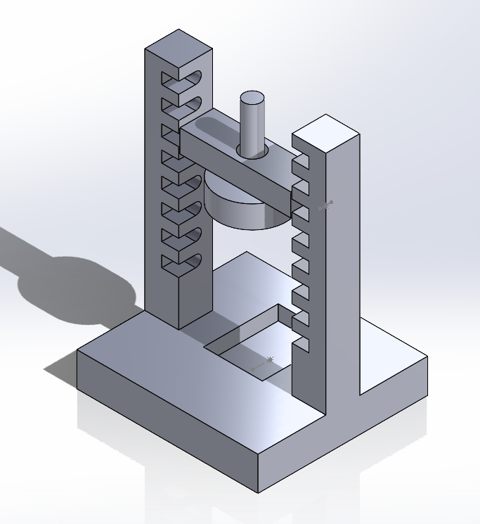
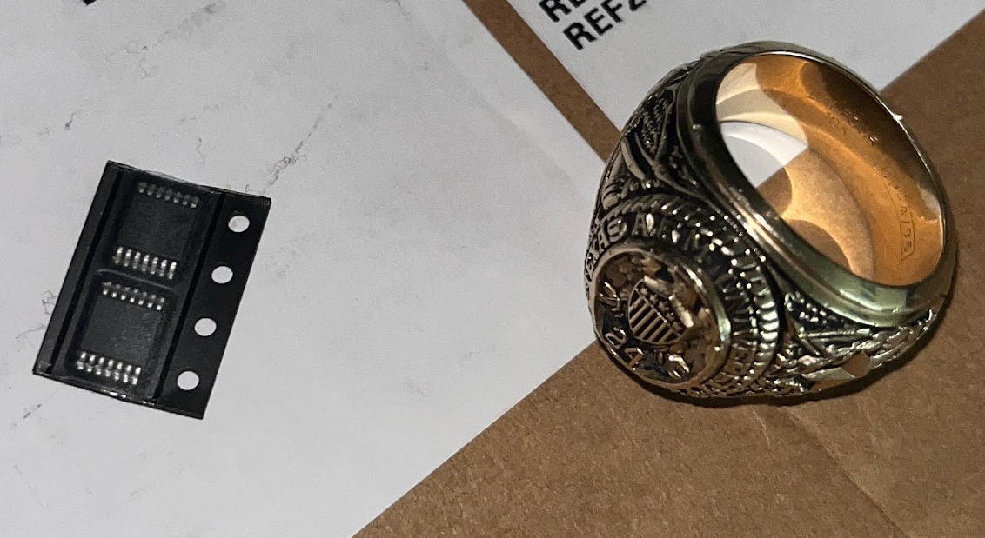
Hall effect sensor testing apparatus
Part modeled using the Hall effect sensor schematics
Will insert the Hall effect sensor in bottom slot.
Hall effect sensor arrived - will print soon

Slide 7
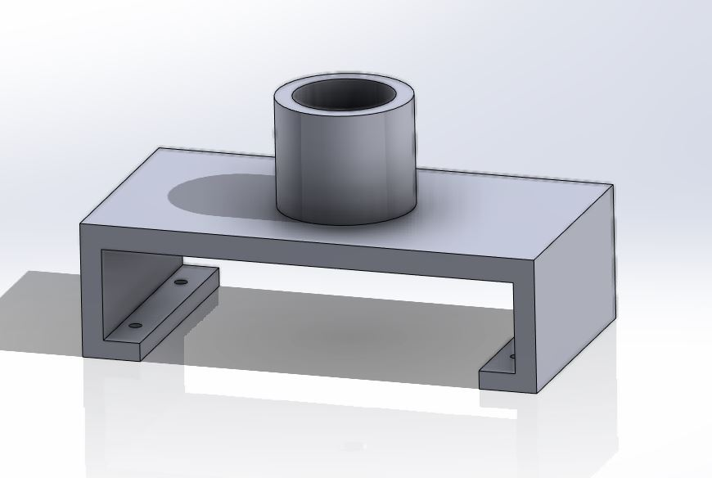
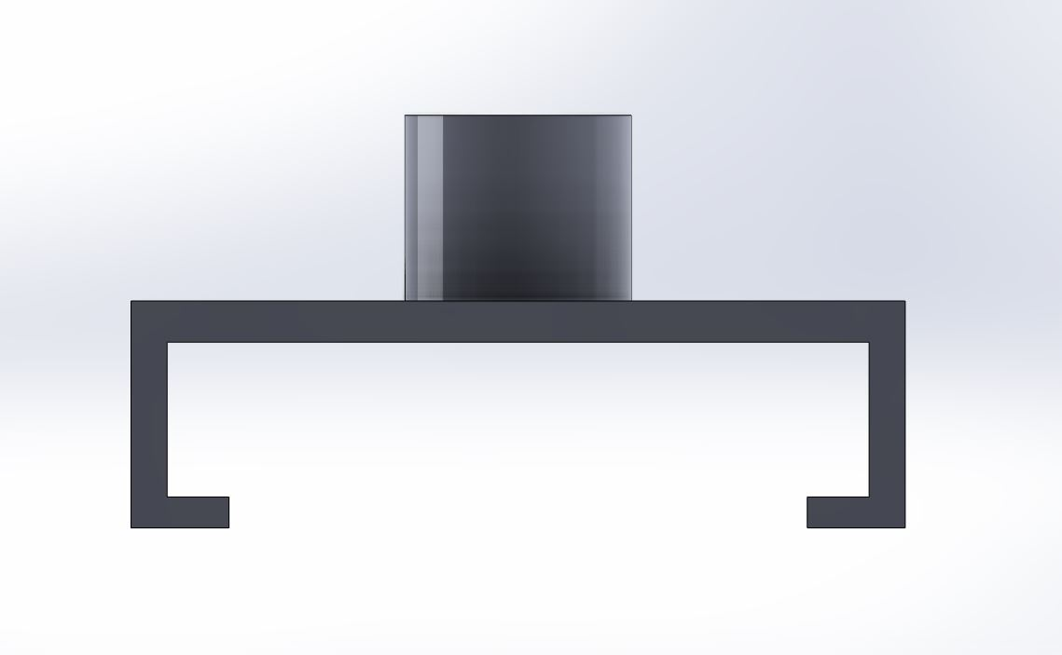
Updated Motor Bracket
2nd iteration of bracket to mount motor on top of actuator
Currently waiting approval/delivery from JCAIN RPS

Slide 8
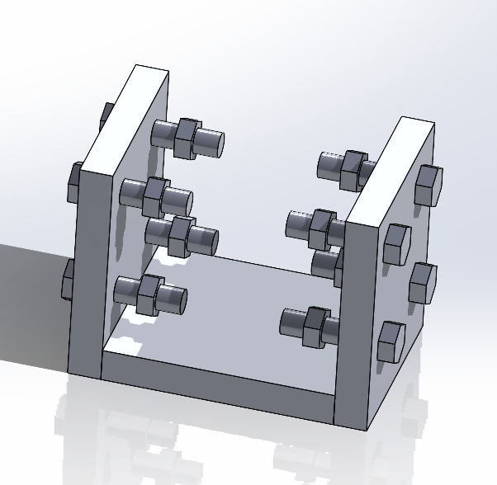
Ball Valve Frame
1” x 6” wood planks
0.75” screw bolts
0.75” nuts and washers
Secures the ball valve in place and holds the potentiometer off the ground.
Plan to check out MEEN card and buy parts from Home Depot tomorrow

Slide 9
Remaining Validation
Drill into stop bolts for strain gauges
Test Hall effect sensor, then insert into valve
Develop a way to firmly attach the electric motor to the actuator
Connect ADC chip to Raspberry Pi to confirm data collection method works

Slide 10
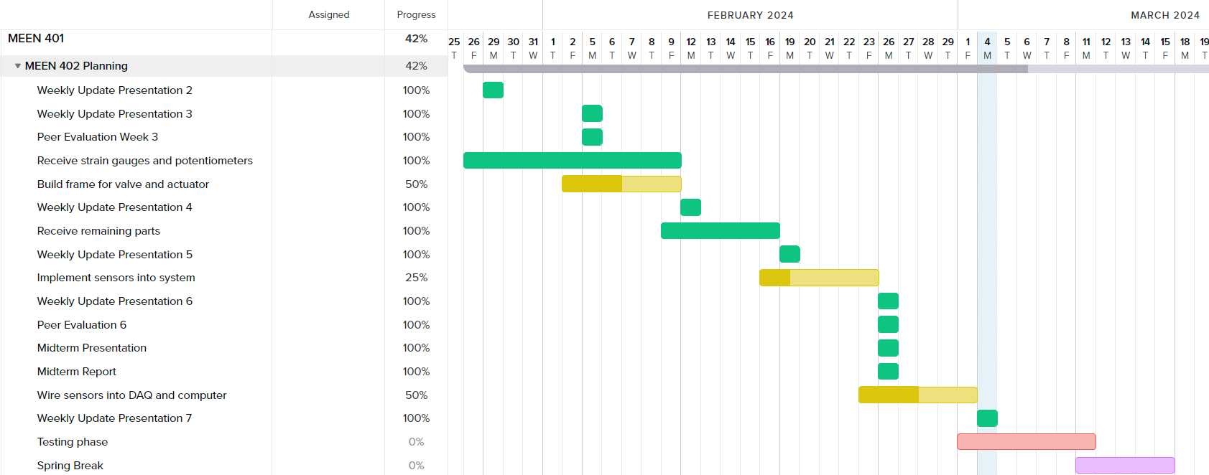
Gantt Chart

Slide 11
Next Week's Deliverables
Tasks | Lead | Percentage Done | Notes
Begin potentiometer validation testing | Avery/Locke | 10% | Potentiometer installed, can test as soon as Pi is up and running.
Build frame for valve and actuator and motor mount | Cody/Travis | 50% | Made design, need to 3D print and connect motor to it.
Implement sensors into system | Zack | 25% | Drill (without breaking stuff) into stop bolts.
Wire sensors into DAQ and computer | Michael | 50% | Working on ADC chip setup.
Test Hall effect sensor | Locke/Travis | 25% | Made design, received sensor, must print.

